Slide 1
Current and future research topics
Mr Eric Lim
MB ChB, MSc (Biostatistics), MD, FRCS (C-Th)
Consultant Thoracic Surgeon
Academic Division of Thoracic Surgery
Royal Brompton Hospital, London, United Kingdom
Reader in Thoracic Surgery
National Heart and Lung Institute
Imperial College, London, United Kingdom

Slide 2
Disclosures
Consultancy / Advisory Board
  Strategen, Abbott Molecular, Glaxo Smith Klein, Pfizer, Norvatis, Covidien, Ethicon
Educational presentations / speaker
  Roche, Imedex, Glaxo Smith Klein, Lily, Pfizer, Medela, Boehringer Ingelheim, Ethicon
Travel, accommodation and course fees
  Covidien, Medela
Research funding
  ScreenCell®, Meleda
Other
  Founder of Informative Genomics (blood based molecular diagnostics laboratory)
  Director of the BUPA Cromwell Lung Cancer Screening Programme
  Chief Investigator for MARS 2 – surgery versus no surgery for mesothelioma
  Chief Investigator for VIOLET – VATS versus thoracotomy for lung cancer

Slide 3
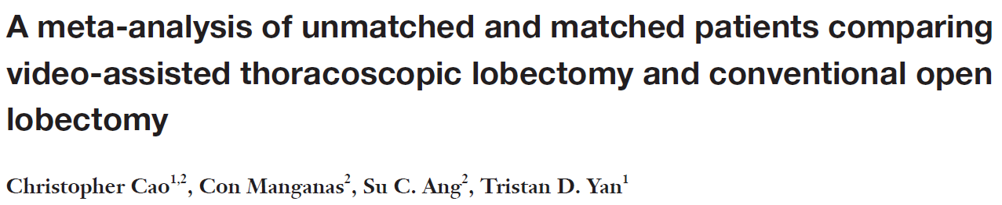
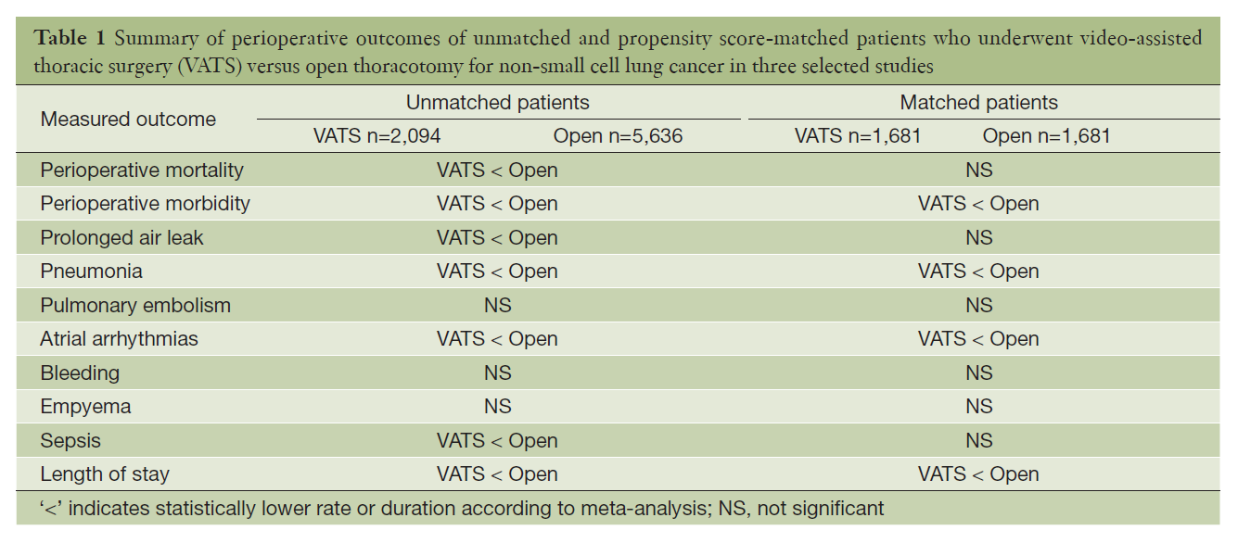


Slide 4
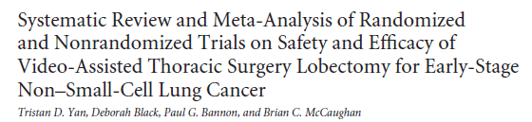
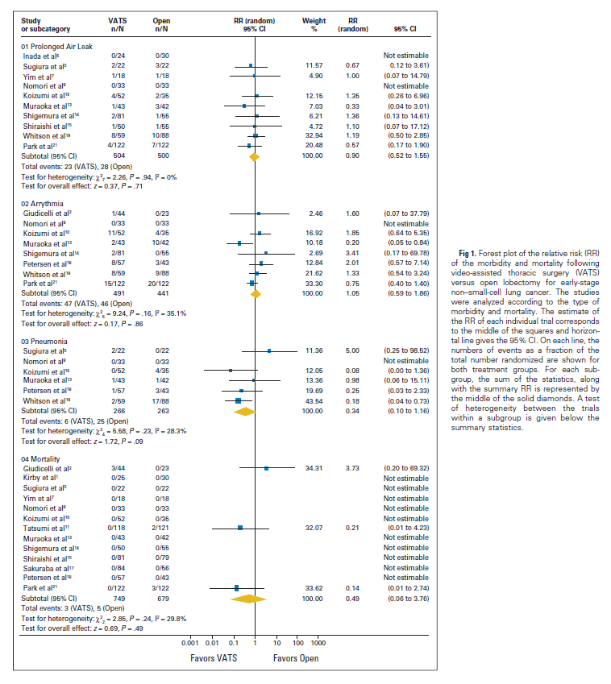
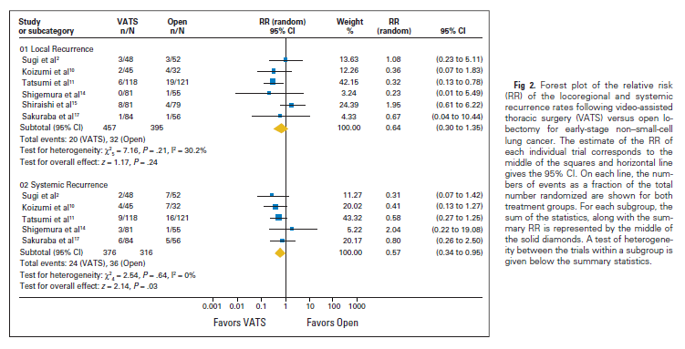

Slide 5
Majority of current evidence
Presented almost exclusively from non-randomised cohort studies
When development of VATS lobectomy was associated with many “can-be-done” publications
Selection bias is a real issue:
  Earlier stage cases (peripheral disease)
  Fitter patients
  More technically able surgeons
  Fast track protocols for better post-operative management

Slide 6
First generation of randomised trials
Trial | Year | n | Outcome | Conclusion
Kirby | 1995 | 55 | Chest drain, stay, pain | No difference with VATS
Sugi | 2000 | 100 | Stage IA 1 year survival | No difference with VATS
Shigemura | 2004 | 39 | Operating time, blood loss, pain, stay | VATS is feasible

Slide 7
Current research topics

Slide 8
What’s the benefit of VATS?
Collect the data prospectively ($10)
Define each complication consistently ($100)
Include an unbiased comparison arm ($1,000)
Use each surgeon has his/her own internal control ($10,000)
Have many centres so we know if it is applicable ($100,000)
Based on a single most important outcome ($1,000,000)
Collection of other secondary important outcomes ($2,000,000)

Slide 9
Current registered RCTs (VATS versus open)
 | Registered | Location | Open | Sample size | Primary outcome | Completion
PLEACE | 2011 | Denmark | Thoracotomy | 500 | Pain | 2015
SCOPE | 2013 | Netherlands | Thoracotomy | 176 | QoL | 2015
Chinese RCT 1 | 2011 | China | Thoracotomy | 1000 | Survival | 2016
Chinese RCT 2 | 2010 | China | Axillary thoracotomy | 400 | Disease free survival | 2018
VIOLET | 2015 | UK | Thoracotomy | 498 | Physical function | 2019
Lungsco01 | 2015 | France | Thoracotomy | 600 | ICER (respiratory complications) | 2018

Slide 10
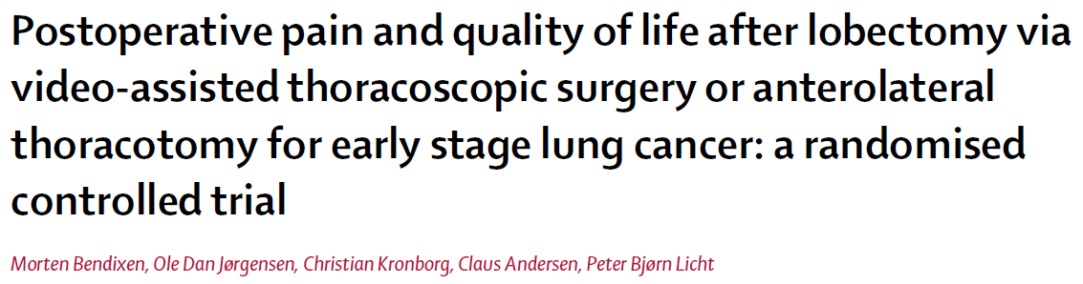
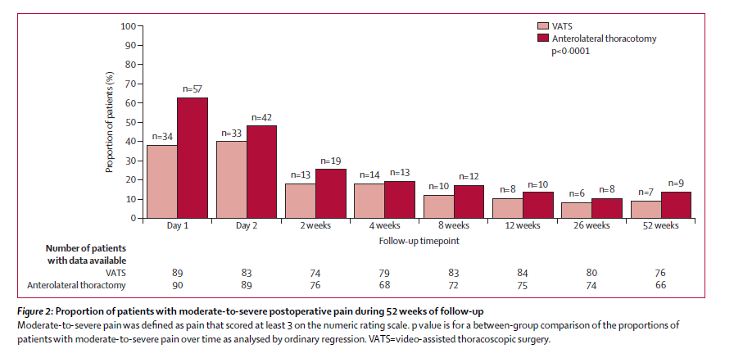


Slide 11
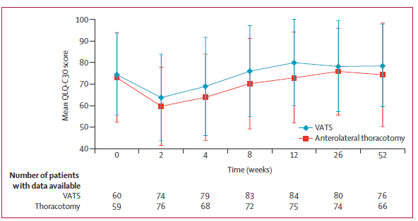

Slide 12
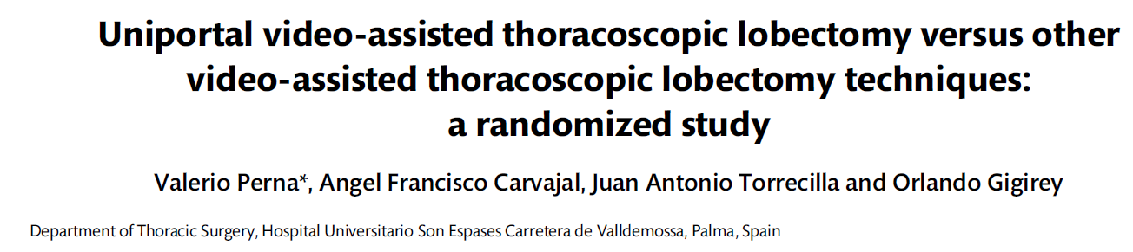
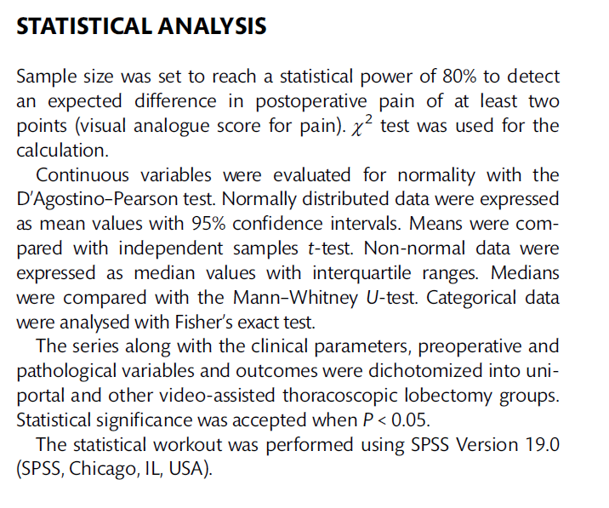
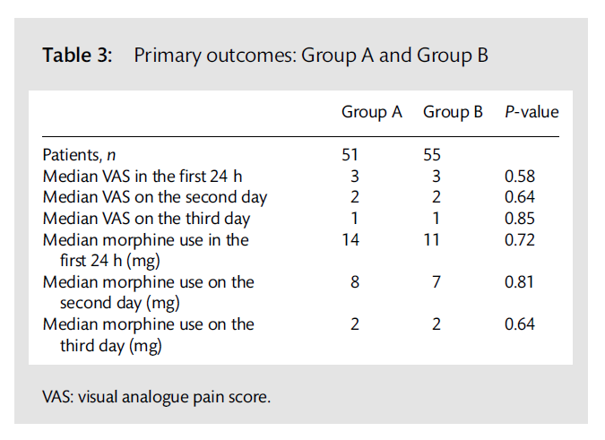

Slide 13
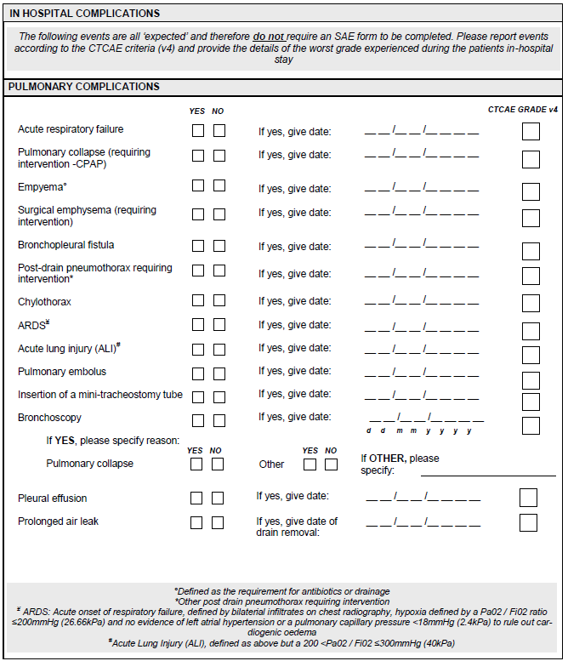
Evidence from randomised trials is key
Centre as a stratification variable
  Eliminate differences in cost and practices
Surgeon as a randomisation unit
  Eliminate differences in surgical skill set
Prospectively defined adverse events
  Independent regular monitoring

Slide 14
Future research topics

Slide 15
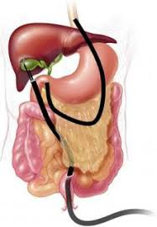
Innovation
Can we do minimal access surgery in a completely new way?
Natural orifice surgery
  Bronchoscopic lung resection
  Trans-oesophageal / gastric surgery
Electroporation
Highly niche and well funded environments that clinicians are unlikely to participate

Slide 16
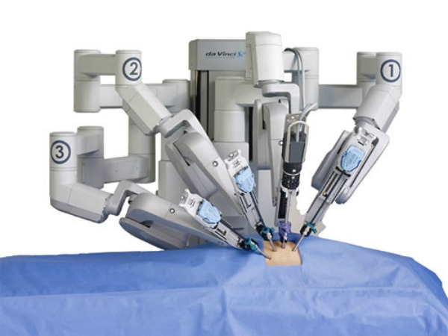
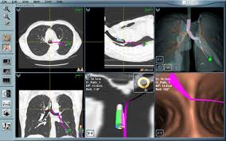
Clinical validation of techniques and adjuncts
Can we improve on minimal access surgery?
Access
  Sub-xiphoid
  Microlobectomy
Adjuncts
  Robotics (ROMAN trial)
  Electromagnetic navigation
  Integrated intra-operative imaging

Slide 17
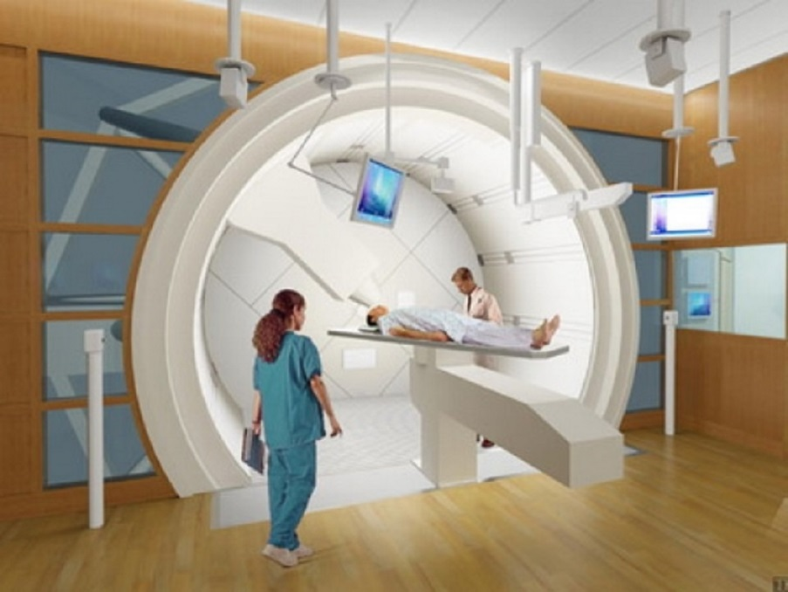
Minimal access surgery versus competing intervention
Will we be able to continue with minimal access surgery?
  Minimal access surgery (sublobar resection) versus SABR / proton beam therapy
  Minimal access lung resection versus immunotherapy

Slide 18
Value proposition for surgical trials
 | Widely used | Meaningful difference | Cost implication*
VATS (vs open) | Yes | Possibly | Yes
Innovation | No | ? | ?
Other minimal access | No | Unlikely | Unlikely
Adjuncts | Not yet | Unlikely | Yes
Competing interventions | Yes | Possibly | Yes
*Non extreme cost implication with respect to clinically meaningful difference

Slide 19
Conclusions
Current questions
  Defining the clinical and cost effectiveness of keyhole (versus open) surgery
Future questions
  Innovation is a niche research area that will continue
  Clinical research is likely to be focused on issues that are
    are widely applicable
    have meaningful potential difference
    with non-extreme cost implications (with respect to the difference)

Slide 20
Thank you!
www.PracticalStatisticsCourse.com

